Slide 1
Inpainting with repeated filterng
CMPUT 206
Instructor: Nilanjan
Department of Computing Science

Slide 2
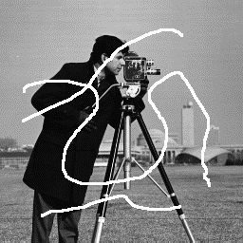
Image inpainting
How do we repair damaged pixel locations?

Slide 3
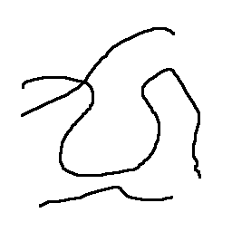
Repeated filtering as a first rescue
Note that you know which pixel locations are damaged. This is available by means of a mask image

Slide 4
Algorithm
Input: Damaged image, I and Mask U
Output: Repaired image,J
Step 1: J = I
Repeat
J = GaussianSmooth(J) # Smooth damaged image
J(U) = I(U) # Copy good pixels
Let’s look at the demo

